Slide 1
Crowdout and Corruption
The relationship between NGOs and state governance Blaine Finstein

Slide 2
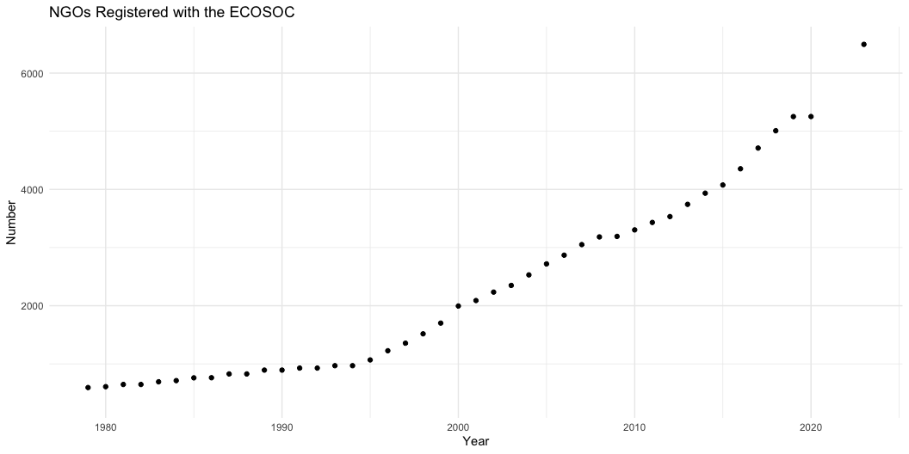
NGOs by the Numbers

Slide 3
NGOs in the Literature
When NGOs do feature in the literature, they are often framed in a positive light. They are thought to pressure states into good governance, with evidence linking them to voter mobilization, political participation and protest, and reduced corruption.

Slide 4
Why is this a problem?
Many of these are qualitative case studies and include co-authors employed by the NGOs studied. This leads to real questions about the generalizability of findings and bias.
In sum, NGOs constitute a rapidly growing sector with the theoretical potential to influence politics, but we have limited and questionable data as to how it does so.

Slide 5
Corruption
Service delivery is a marketplace and government and NGOs are substitutes. When NGOs enter the market and crowd out government institutions, what happens to public funds? Does government extend the work of NGOs, or is it corrupted?
Previous studies argue that NGOs reduce corruption by increasing voters’ expectations of government, but this relies on a good information environment. Voters have to be able to distinguish between NGOs and the government.

Slide 6
In the case of the Philippines, this is unlikely. Politicians claim credit for local development projects from international aid that they had no hand in and reap electoral returns. If credit claiming occurs for NGO projects as well, then voters would think that state governance has already improved.

Slide 7
Research Question
Is there an association between NGO spending and the corruption of public budgets?

Slide 8
Measuring Corruption
Historically, social scientists have relied on surveys to gauge corruption. This (1) relies on citizen perception matching real corruption levels and (2) restricts hypothesis testing to the geographic unit at which the survey is statistically significant.
A number of recent papers have turned to machine learning, using audit and budgets reports for supervised and unsupervised models.

Slide 9
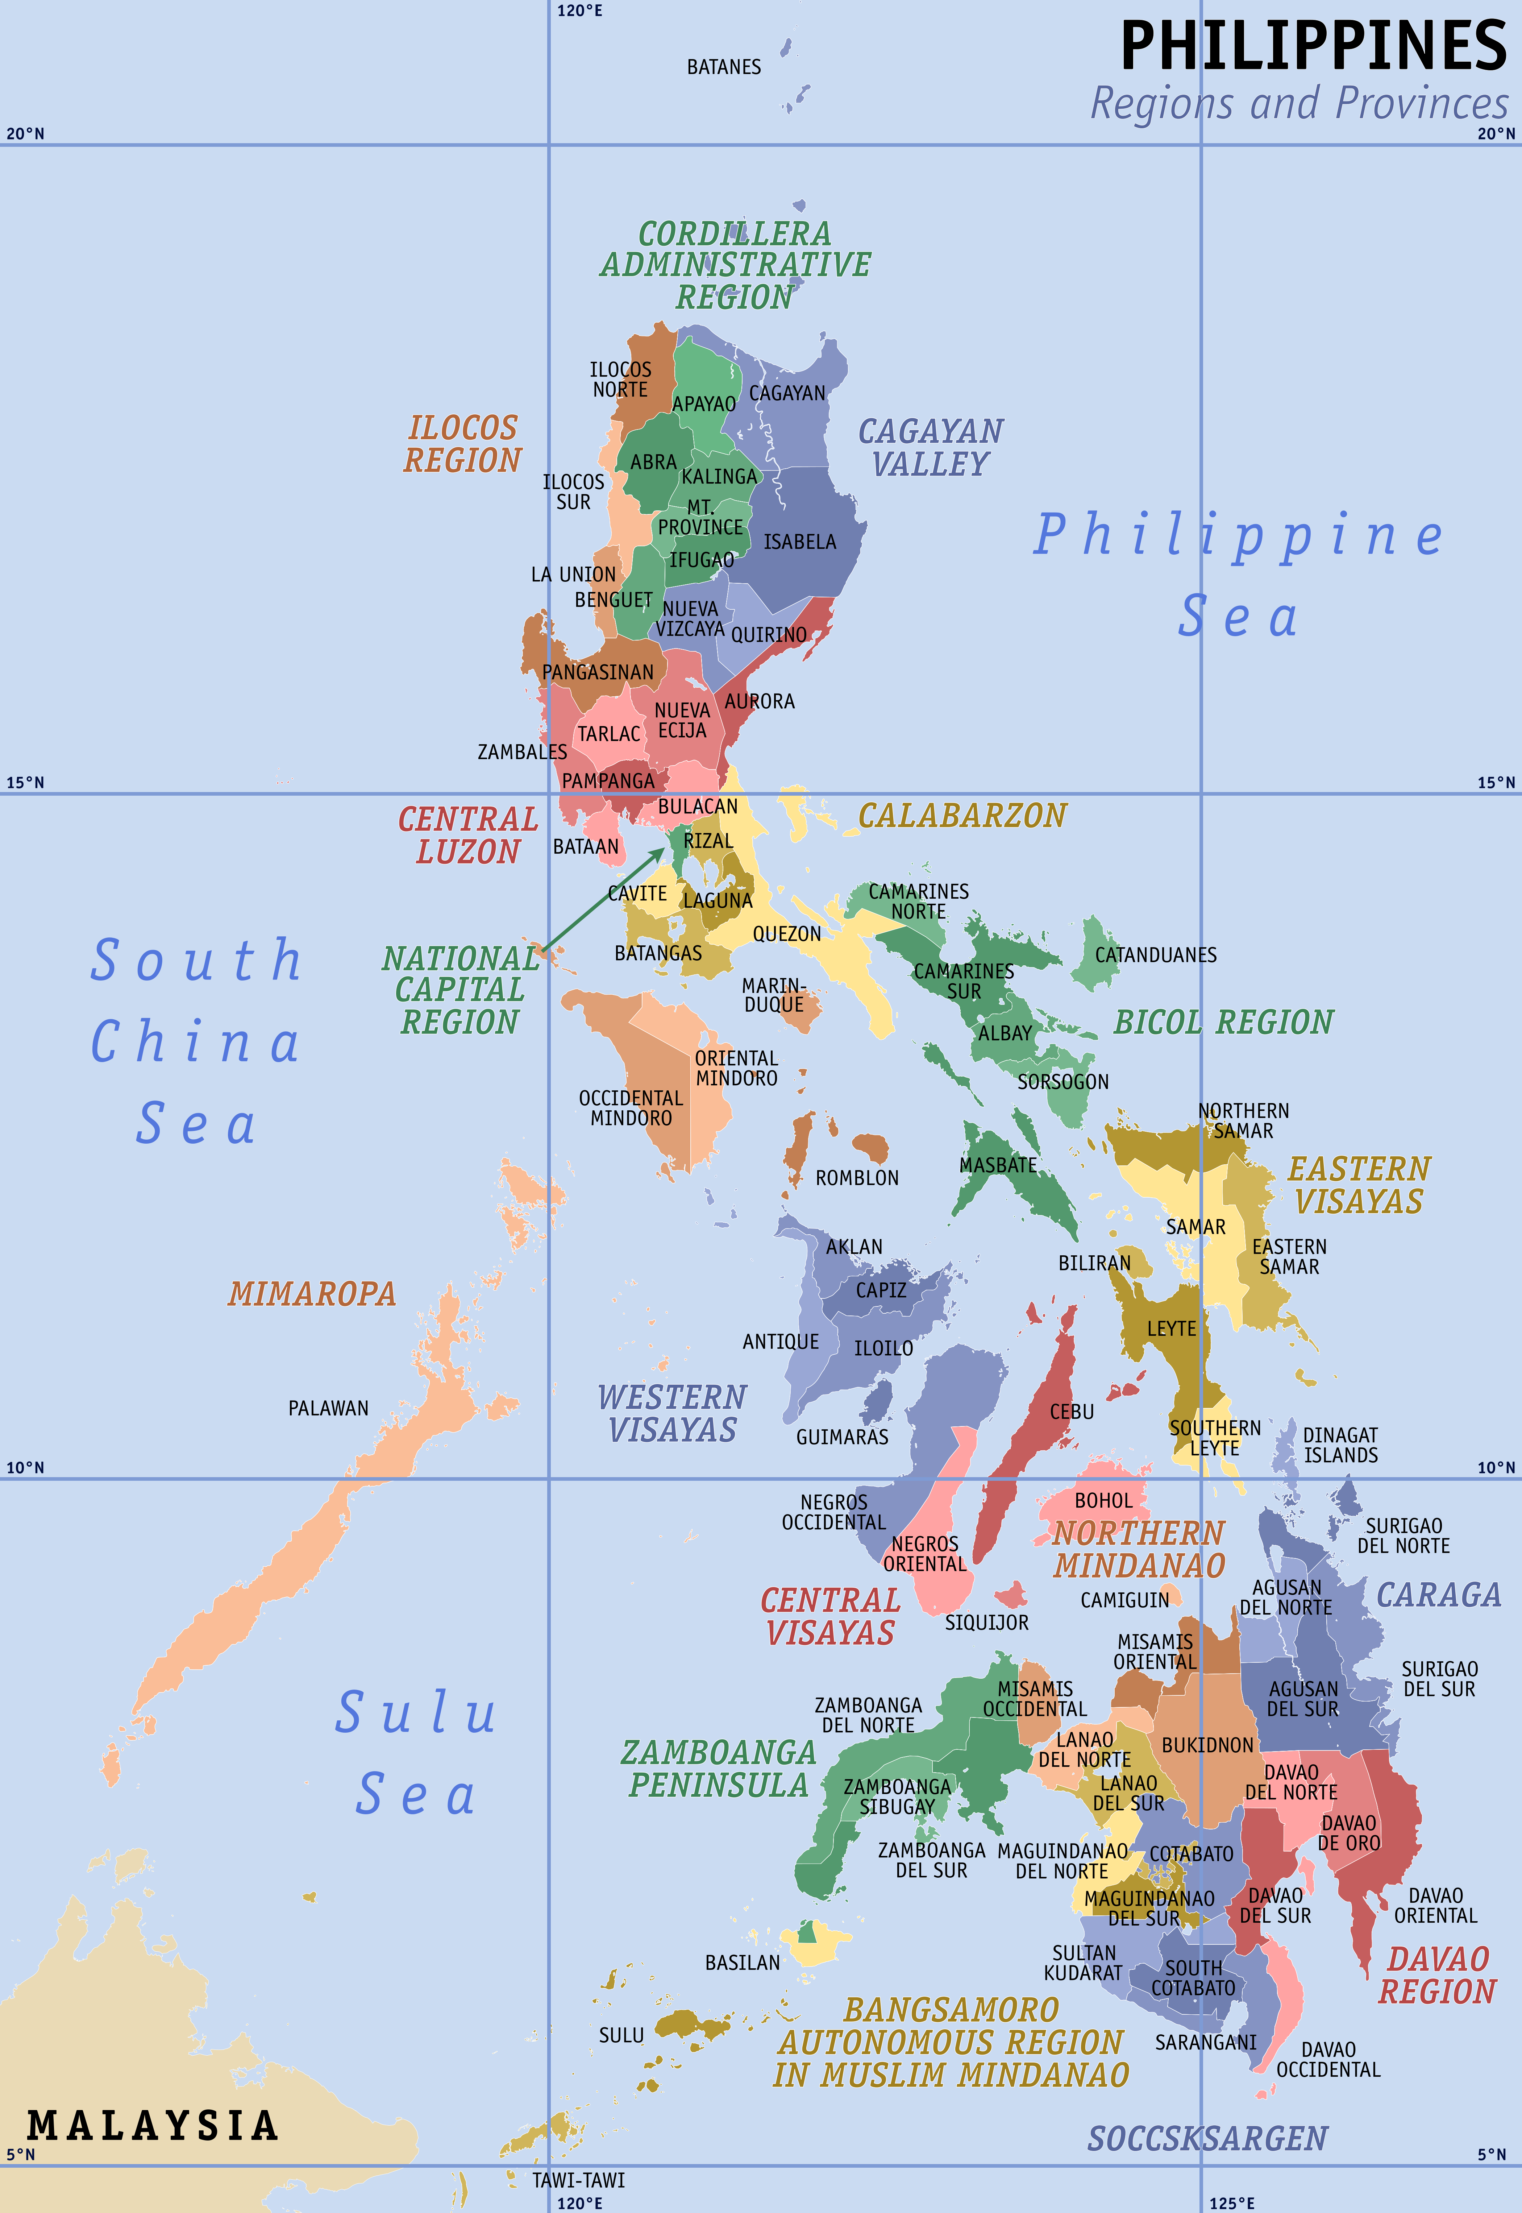
Regional Variation in the Philippines
1489 municipalities x 11 years = 16379 observations

Slide 10
Next Steps
Create a data set from the budget report PDFs (crash course in regular expressions)
Solidify NGO measurement depending on available data
I would ideally analyze NGO expenditures, but may use NGO proliferation (number of NGO offices in the municipality) or foreign aid expenditures (available from AidData)
Ponder robustness checks for budget anomaly detection, potentially corroborate corruption predictions with public scandals from Philippine newspapers

Slide 11
Course Overlaps
Exploiting subnational variation to expand data sets
Unit construction and variable measurement - the effect of a group on money in politics linked by region and time

